Slide 1

HACKATHON – SAC & B1 Creating Calculation Views in SAP HANA

Slide 2
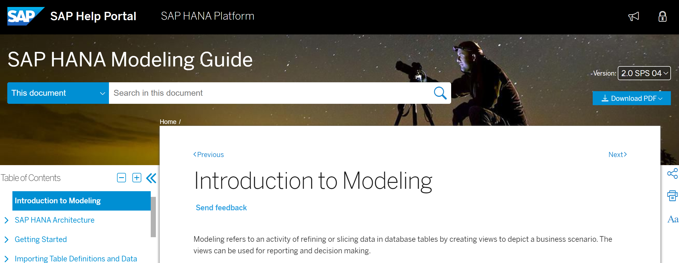
SAP HANA Modeling Guide
https://help.sap.com/viewer/fc5ace7a367c434190a8047881f92ed8/2.0.04/enUS/4c1652b4bf39481db9c6b52f6b43a377.html

Slide 3
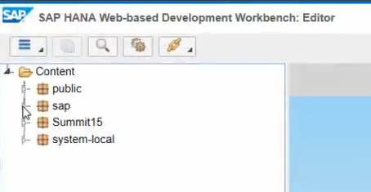
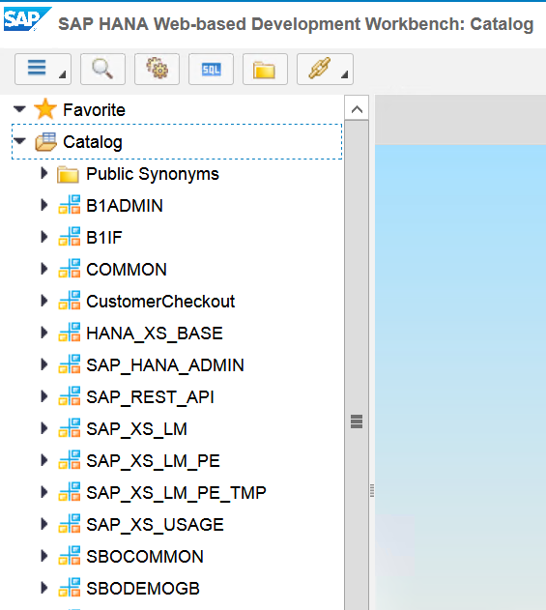
Working with SAP HANA Web IDE
Open Browser
http://hanab1:8000/sap/hana/ide/editor http://hanab1:8000/sap/hana/ide/catalog
editor
catalog

Slide 4
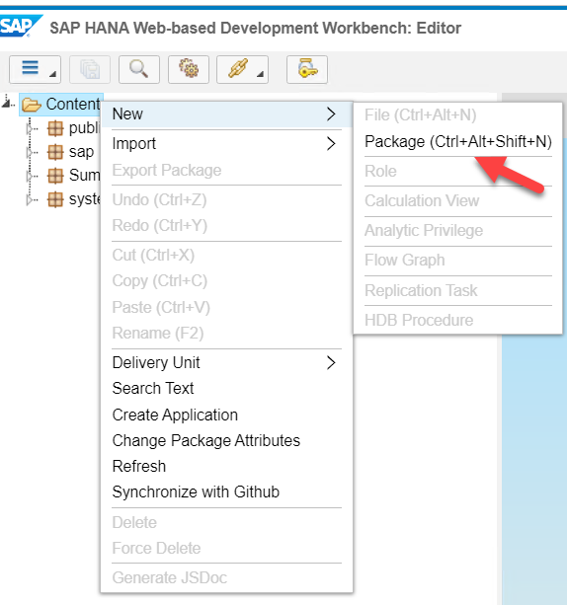
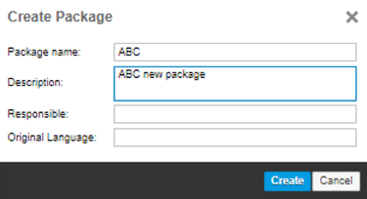
Create a new package Content → New → Package (with your NAME / PROJECT)

Slide 5
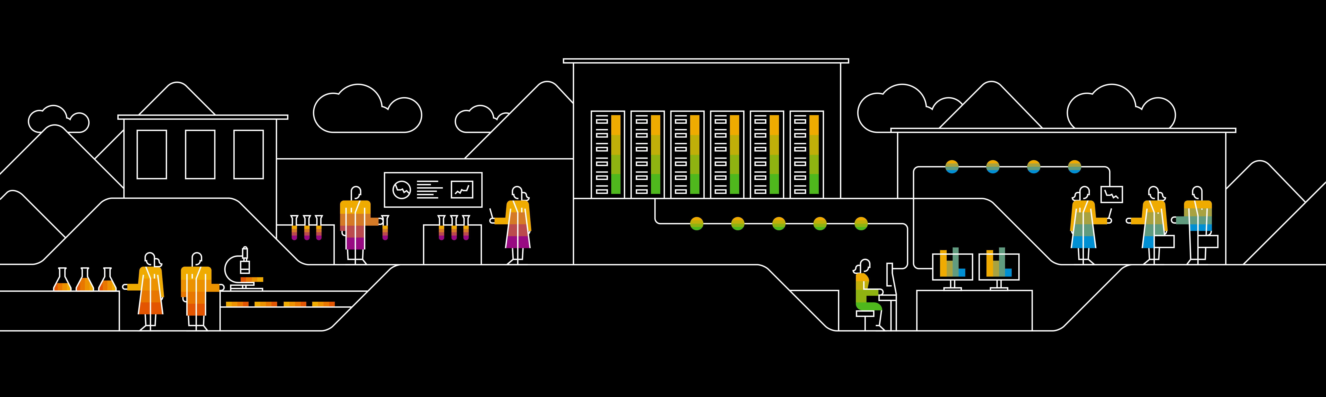
Example 1 Target: Calculation View with NET SALES Vales: SALES – CREDIT MEMOS group by Year, Quarter and Month

Slide 6
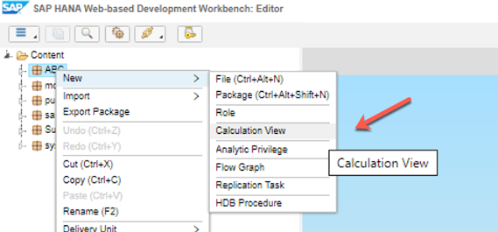
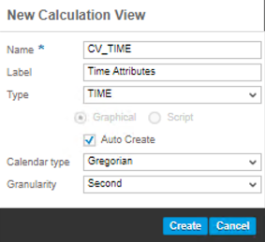
Create new Calculation View
Name: CV_TIME
Type: TIME
Graphical
Calendar type: Gregorian
Granularity: Second

Slide 7
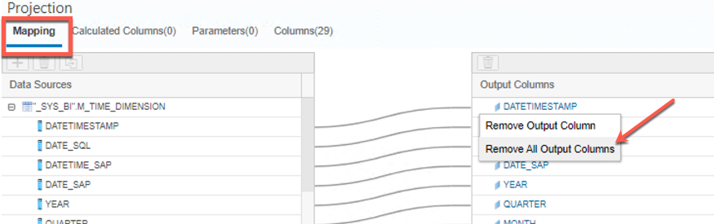
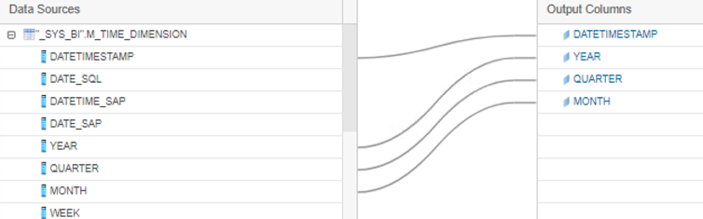
Output Columns
Click in “Projection”
Click in “Mapping”
Remove all Output Columns
Select to Output only 4 columns:
DATETIMESTAMP
YEAR
QUARTER
MONTH
Granularity: Second

Slide 8
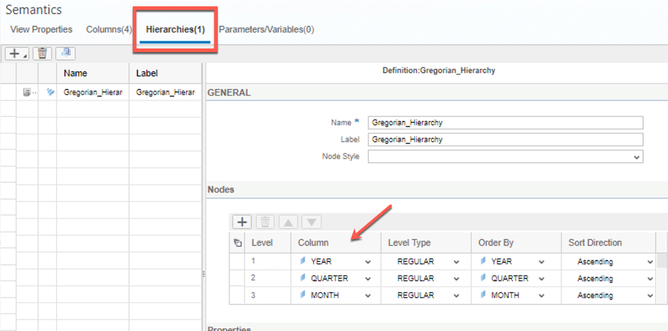
Output Columns
Click in “Hierarchies”
Add Columns ordering by:
YEAR
QUARTER
MONTH

Slide 9
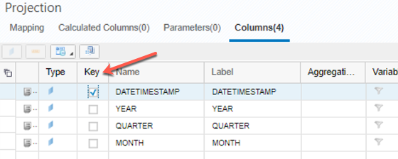
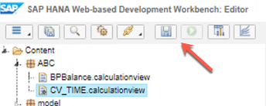
Output Columns
Click in “Columns”
Set DATETIMESTAMP as key field.
Save

Slide 10
Context
Customer Dimension
Product Dimension
Star joins in calculation views help you to join a fact table with dimensional data.
The fact table contains data that represent business facts such price, discount values, number of units sold, and so on.
Dimension tables represent different ways to organize data, such as geography, time intervals, contact names, and more.
Customer Product Employee Date
Sales Revenue Gross Profit
Sales Employee Dimension
Time Dimension

Slide 11
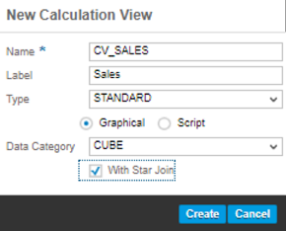
Create new Calculation View - SALES
Name: CV_SALES
Type: STANDARD
Graphical
Data Category: CUBE
SET with Star Join

Slide 12
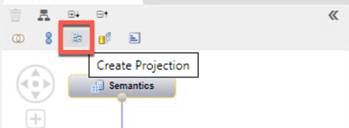
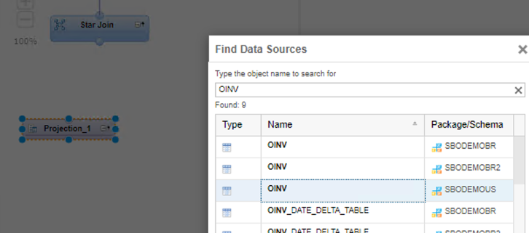
Create Projection
Click “Create Projection” button
Scroll the mouse to create a new projection.
Add OINV table into the projection.

Slide 13
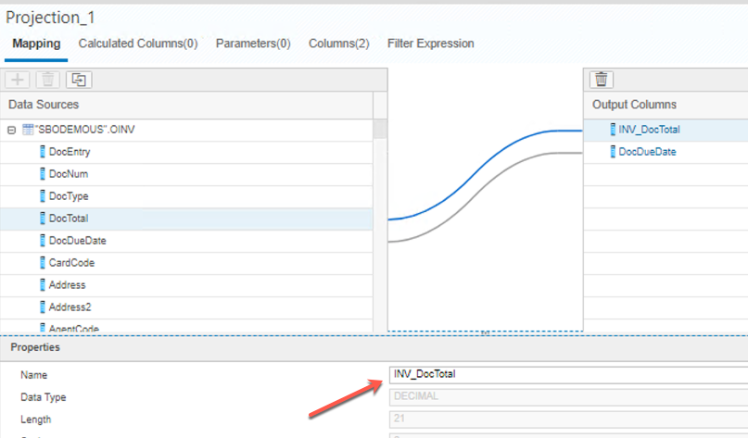
Output Columns
Select following columns to Output:
DocDueDate
DocTotal
Click in the field “DocTotal” and in the Properties board, rename it to:
INV_DocTotal

Slide 14
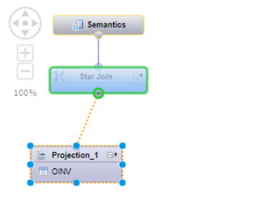
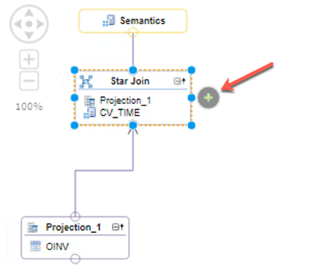
Create a Join Definition
From the “Projection1”, drag and drop a node between the Projection 1 and Star Join
Add CV_TIME already created into Star Join board.

Slide 15
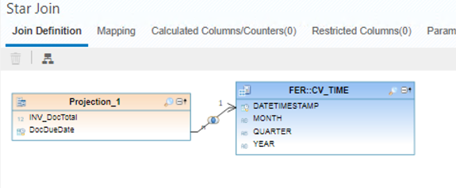
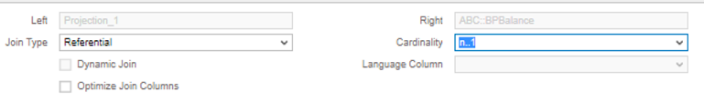
Create a Join Definition
From the “Projection1”, drag and drop a node between the Projection and CV_TIME
Key Fields: DocDueDate
DATETIMESTAMP
Cardinality: n..1

Slide 16
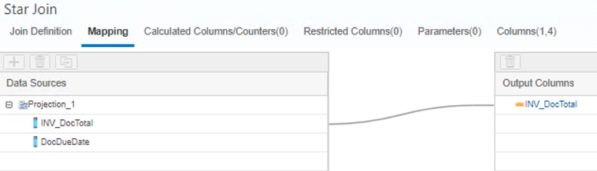
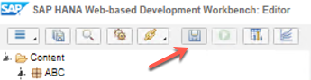
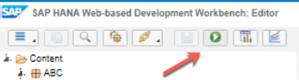
Star Join – Output Columns
In Star Jopin, click “Mapping” and add the following column to output:
INV_DocTotal
Save
Run Calculation View

Slide 17
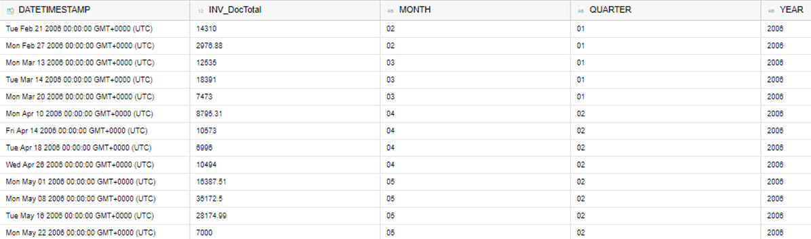
CV_SALES – R esult Expected
Result Expected

Slide 18
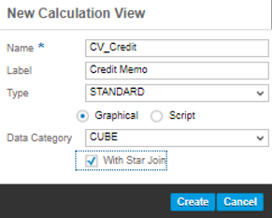
Create new Calculation View – CREDIT MEMO
Name: CV_CREDIT
Type: STANDARD
Graphical
Data Category: CUBE
SET with Star Join

Slide 19
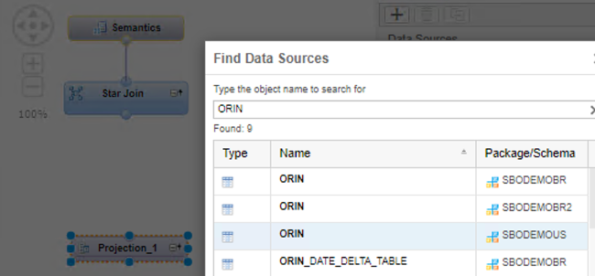
Create Projection
Click “Create Projection” button
Scroll the mouse to create a new projection.
Add ORIN table into the projection.

Slide 20
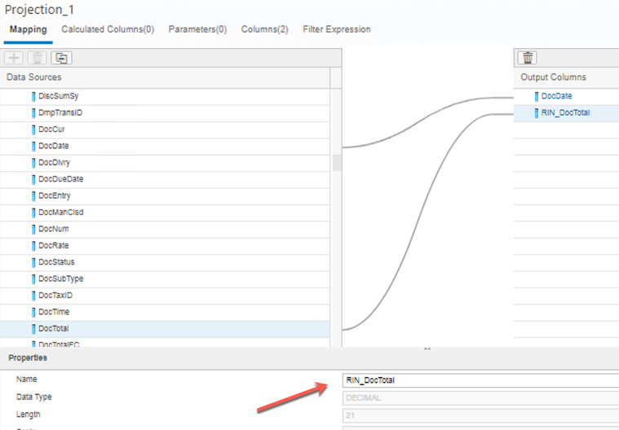
Output Columns
Select following columns to Output:
DocDate
DocTotal
Click in the field “DocTotal” and in the Properties board, rename it to:
RIN_DocTotal

Slide 21
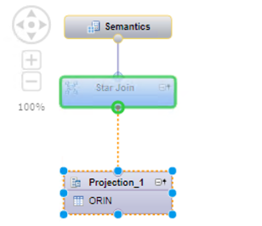
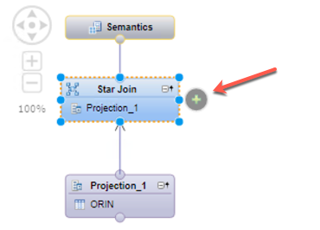
Create a Join Definition
From the “Projection1”, drag and drop a node between the Projection 1 and Star Join
Add CV_TIME already created into Star Join board.

Slide 22
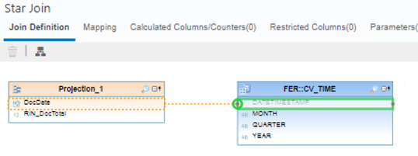
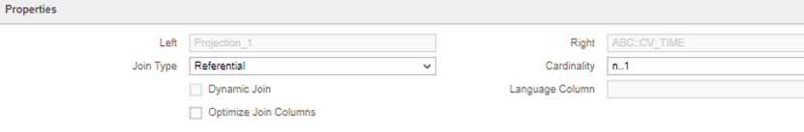
Create a Join Definition
From the “Projection1”, drag and drop a node between the Projection and CV_TIME
Key Fields: DocDate
DATETIMESTAMP
Cardinality: n..1

Slide 23
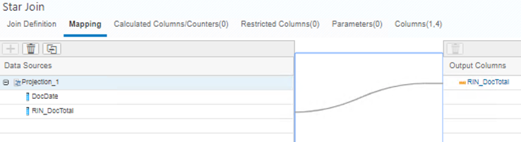
Star Join – Output Columns
In Star Join, click “Mapping” and add the following column to output:
RIN_DocTotal
Save
Run Calculation View

Slide 24
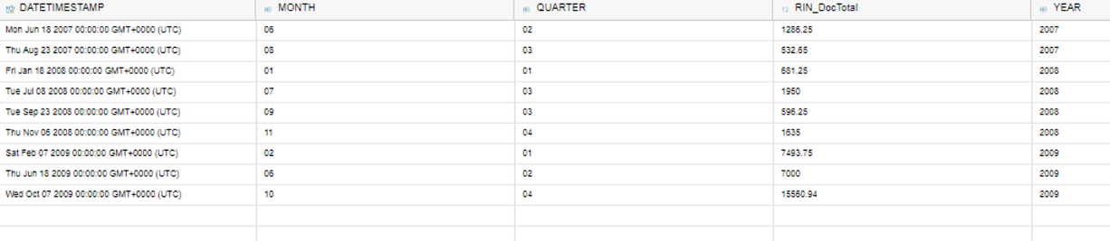
CV_CREDIT – Result Expected
Result Expected

Slide 25
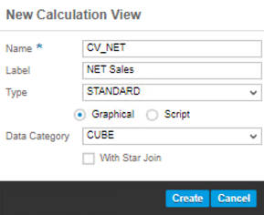
Create new Calculation View – NET SALES
Name: CV_NET
Type: STANDARD
Graphical
Data Category: CUBE

Slide 26
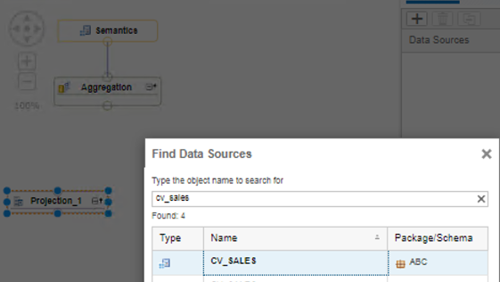
Create Projection - SALES
Click “Create Projection” button
Scroll the mouse to create a new projection.
Add CV_SALES into the projection.

Slide 27
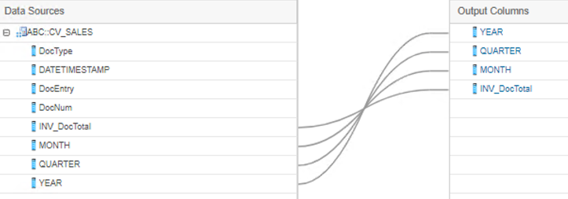
Output Columns
Select following columns to Output:
YEAR
QUARTER
MONTH
INV_DocTotal

Slide 28
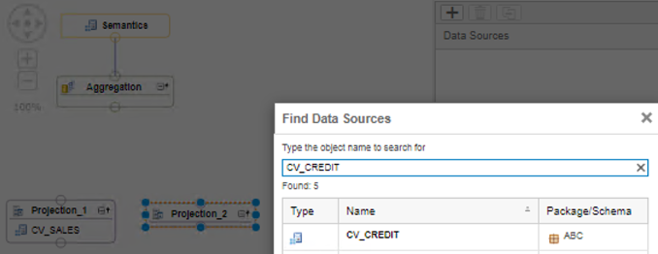
Create Projection – CREDIT MEMO
Click “Create Projection” button
Scroll the mouse to create a new projection.
Add CV_CREDIT into the projection.

Slide 29
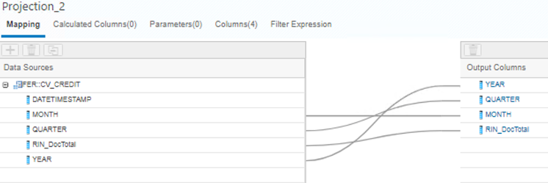
Output Columns
Select following columns to Output:
YEAR
QUARTER
MONTH
RIN_DocTotal

Slide 30
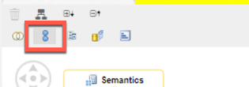
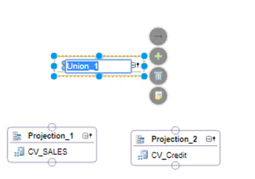
Create Union
Click “Create Union” button
Scroll the mouse to create a new projection.

Slide 31
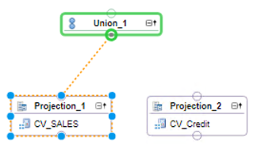
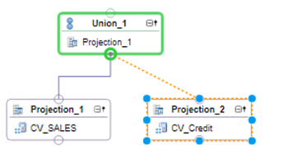
Create Union definition
From the “Projection1”, drag and drop a node between Projection 1 and Union 1
From the “Projection2”, drag and drop a node between Projection 2 and Union 1

Slide 32
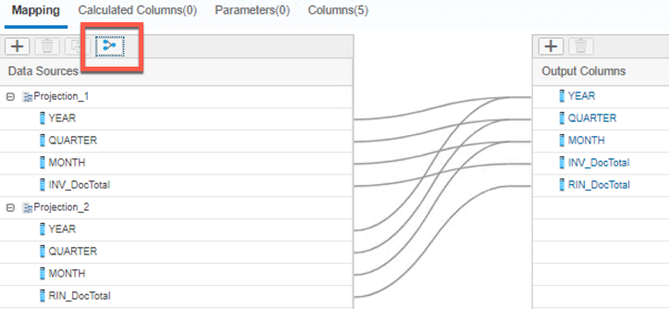
Output Columns
Click in the “Union 1”.
Click in “Mapping” tab
Click in “Auto Map by Name” button

Slide 33
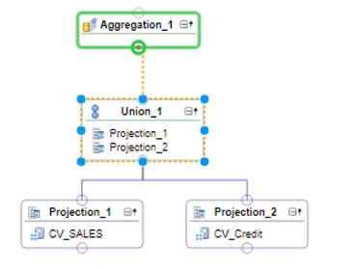
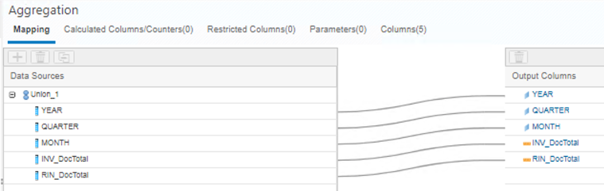
Create Aggregation definition
From the “Union1”, drag and drop a node between Union 1 and Aggregation 1
Click in “Aggregation 1” and “Mapping”
Select following columns to Output:
YEAR
QUARTER
MONTH
INV_DocTotal
RIN_DocTotal

Slide 34
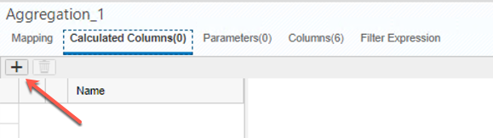
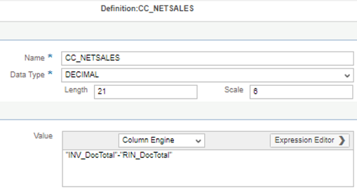
Create Calculated Column
Click in “Calculated Column” tab
Click in “Add” button
Add a new calculated column where:
Name: CC_NETSALES
Data type: DECIMAL
Length: 21
Scale: 6
Expression:
“INV_DocTotal” - “RIN_DocTotal”

Slide 35
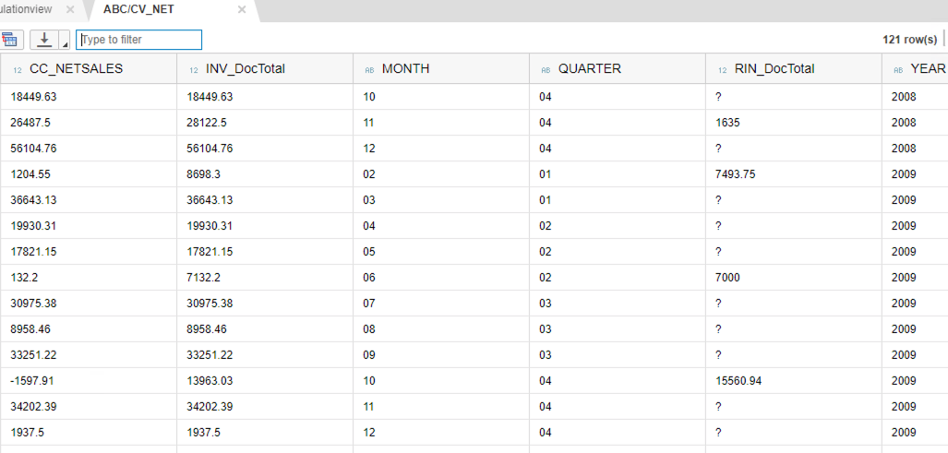
Save and Run
Save
Run the Calculation View
Expected result

